Slide 1
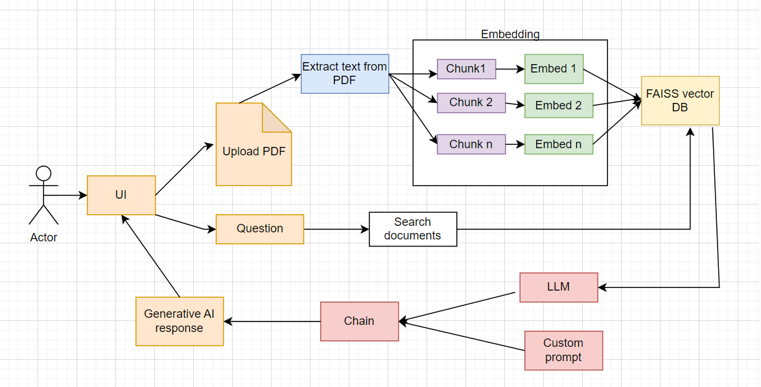
PDF based chatbot architecture diagram:
Business value proposition:
Efficient Document processing
Enhanced User Interaction
Automated Content Analysis
Scalability and Flexibility
Insight Generation
Free of cost
How does it work?
Used Google Generative AI Embeddings
Stored embeddings in FAISS vector store
Written custom prompt for LLM for response generation
Used Gemini-pro LLM model from Google
Based on similarity search, response is generated by LLM
Integrated with Streamlit for user interface

